Slide 1
Introduction to Computer Programming Lecture 11.1:
Review : Operators and Data Structures
Hemma Philamore
Department of Engineering Mathematics

Slide 2
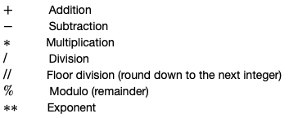

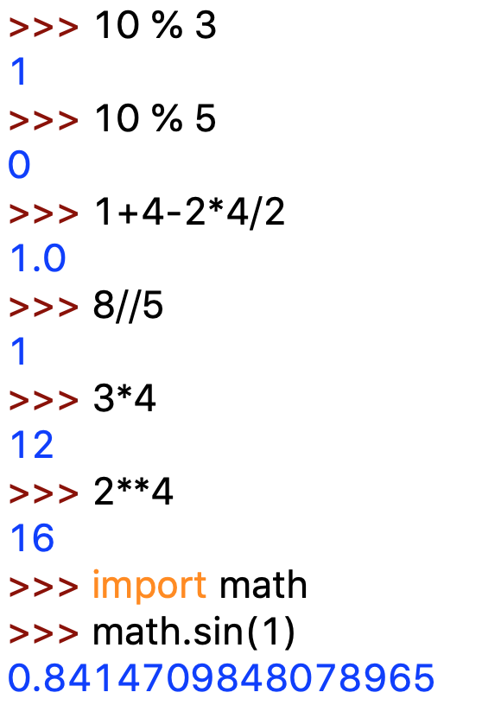
Mathematical operators
multiplication
% modulo
exponent
// floor division
additional functionality

Slide 3
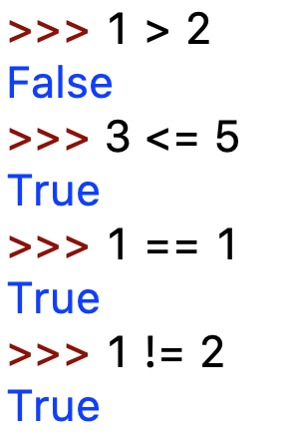
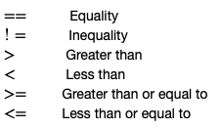
Boolean operators

Slide 4
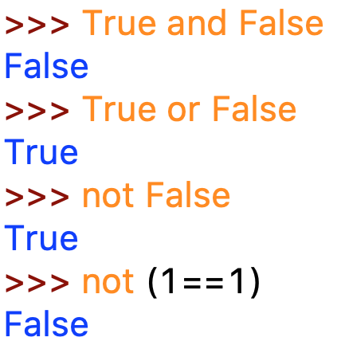
Logical operators
Compare the outcome of two Boolean operations
and : both are true
or : either are true
not: negates the outcome of a conditional
>>> (1 > 2 and 3 < 4)
False
>>> (1 > 2 or 3 < 4)
True
>>> not(1 > 2 or 3 < 4)
False
>>> not(1 > 2) and 3 < 4
True

Slide 5
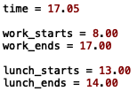


Operators are combined to produce compound statements
Change the value of time to change the value of lunch_time and work_time
Lunchtime is after lunch begins and before lunch ends
Work time is after works begins, before work ends, and not at lunchtime

Slide 6
Q.11.1.A
Express these statements using mathematical, logic and Boolean operators.
a) An increasing population is when the number of new emigrants and the number of deaths is less than the number of new immigrants and the number of births.
b) Draw two counters of the same colour from a bag of blue and green counters on the first turn and then draw two counters of different colours on the second turn to win the game.

Slide 7

Data Structures
Lists
my_list = [ 1, ‘five’, 3.2]
Tuples
my_tuple = ( cos($θ$) , sin($θ$), 1 )
An ordered collection of items
Mutable : can be altered
(items added, removed, changed)
Holds multiple items together
Immutable : cannot be modified
my_dict = { ‘Engineering Maths’ : 75,
‘Digital Heath’ : [25, 4]
}
Sets
my_set = {2, 2, 1, 2, 5}
Dictionaries
Unordered collections of simple objects.
Used when we are concerned with the existence of an object or membership of a set (rather than exact objects, position in the data structure, or number of occurrences)
Address-book style collection of keys (name) and value (details).
Keys: only immutable objects
Values: mutable/immutable objects

